Slide 1




NEXT GEN EMPLOYABILITY PROGRAM
Creating a future-ready workforce
Team Members
College Name
Student Name : SANDHIYA A
Student ID : 511321205028
KINGSTON ENGINEERING COLLEGE

Slide 2

CAPSTONE PROJECT SHOWCASE
Project Title
Building Bus Reservation System using Python and Django
Abstract | Problem Statement | Project Overview | Proposed Solution | Technology Used | Modelling & Results | Conclusion

Slide 3
Abstract :
The Bus Reservation System is a web application developed using Python Django framework. It aims to provide a convenient and efficient platform for users to book bus tickets online. The system allows users to search for available buses based on their desired route, date, and time. Users can view the available seats on each bus and select their preferred seat(s) for reservation. The system also includes features for user registration, login authentication, and online payment processing for ticket booking. Additionally, administrators have access to a dashboard for managing buses, routes, schedules, and user bookings. The Bus Reservation System offers a seamless experience for both users and administrators, making bus ticket booking hassle-free and efficient.
Source :

Slide 4
Problem Statement :
To Design and develop a Bus Reservation System using Python Django framework to facilitate seamless online booking of bus tickets. The system should provide functionalities for users to search for available buses based on routes, dates, and times, select seats, register/login, and make online payments. Administrators should have access to a dashboard to manage buses, routes, schedules, and user bookings. The system should ensure security, user-friendliness, and efficiency in the booking process, enhancing the overall experience for both users and administrators.
Source :

Slide 5
Project Overview :
The Bus Reservation System is a web-based application developed using the Python Django framework. It provides users with the convenience of booking bus tickets online, eliminating the need for physical ticket counters. The system allows users to search for available buses based on their desired route, date, and time. Once a suitable bus is found, users can select their preferred seats and proceed to book them. To use the system, users need to register and log in securely. Payment for the booked tickets is processed online through secure payment gateways, ensuring a smooth and secure transaction process. Administrators have access to a dedicated dashboard where they can manage buses, routes, schedules, and user bookings efficiently. The Bus Reservation System aims to streamline the bus ticket booking process, providing users with a seamless and hassle-free experience while ensuring effective management for administrators.
Source :

Slide 6
Proposed Solution :
The proposed solution for the Bus Reservation System involves designing and implementing a robust web application using the Python Django framework. Here are the key components and functionalities of the system:
1. User Interface:
- A user-friendly interface for easy navigation and interaction.
- Options for users to search for buses based on route, date, and time.
- Visual representation of available seats on each bus for easy selection.
2. User Authentication:
- Secure user registration and login functionality.
- Authentication mechanisms to ensure user privacy and security.
.
Source :

Slide 7
3. Booking Process:
- Seamless booking process allowing users to select seats and proceed to payment.
- Integration with secure payment gateways for online transactions.
- Confirmation emails to users upon successful booking.
4. Administration Dashboard:
- An admin dashboard to manage buses, routes, schedules, and user bookings.
CRUD (Create, Read, Update, Delete) operations for bus management.View and manage user bookings, including seat allocations and payment status.Database Management:Utilization of Django's ORM (Object-Relational Mapping) for database operations.Efficient database schema design to store user details, bookings, buses, and routes.Security Measures:Implementation of security best practices to protect user data and transactions.
Source :

Slide 8
Encryption of sensitive information such as passwords and payment details.Protection against common web vulnerabilities like SQL injection and cross-site scripting (XSS).Scalability and Performance:Optimization of code and database queries for improved performance.Scalable architecture to accommodate a growing number of users and bookings.Testing and Quality Assurance:Thorough testing of the system to identify and fix bugs.User acceptance testing to ensure the system meets user requirements and expectations.Documentation:Comprehensive documentation covering system architecture, functionalities, and usage instructions.User manuals for both users and administrators to understand and utilize the system effectively.
Source :

Slide 9


Technology Used
Front-end
Back-end
Source :

Slide 10
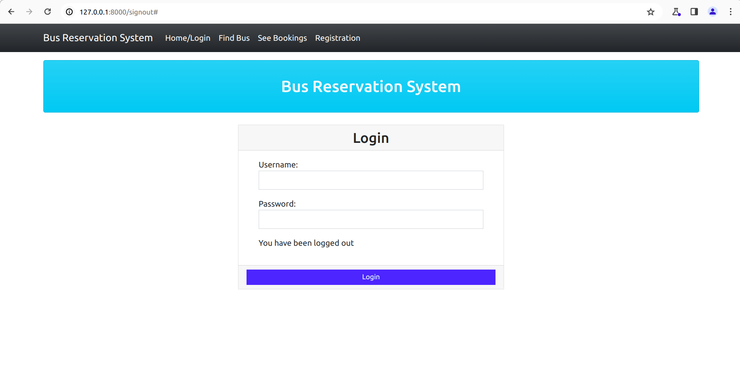
Modelling & Results
Source :

Slide 11
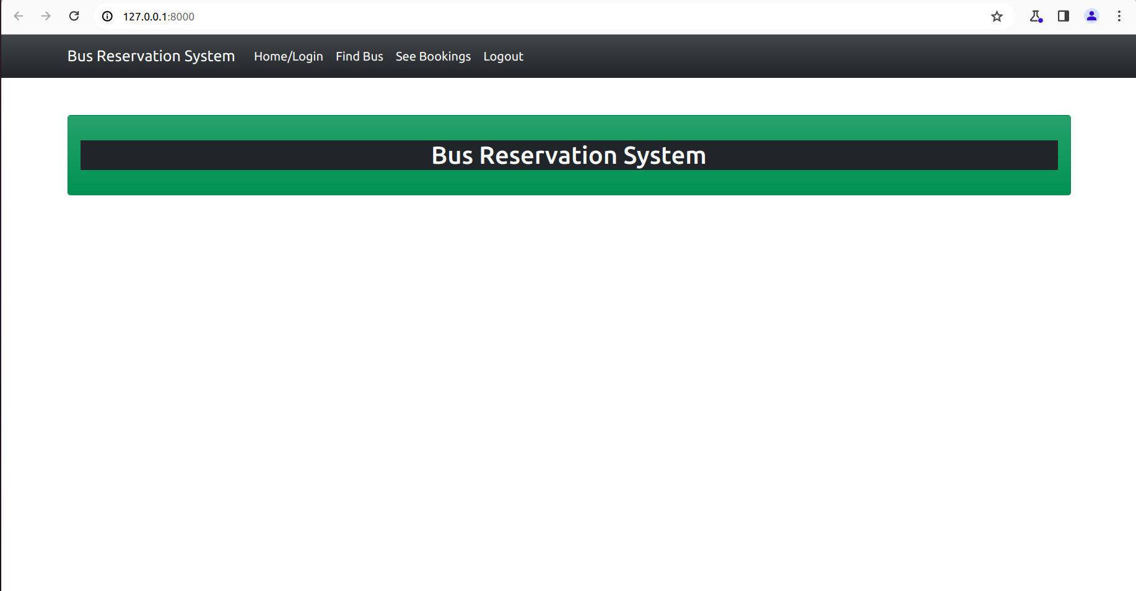
Homepage

Slide 12
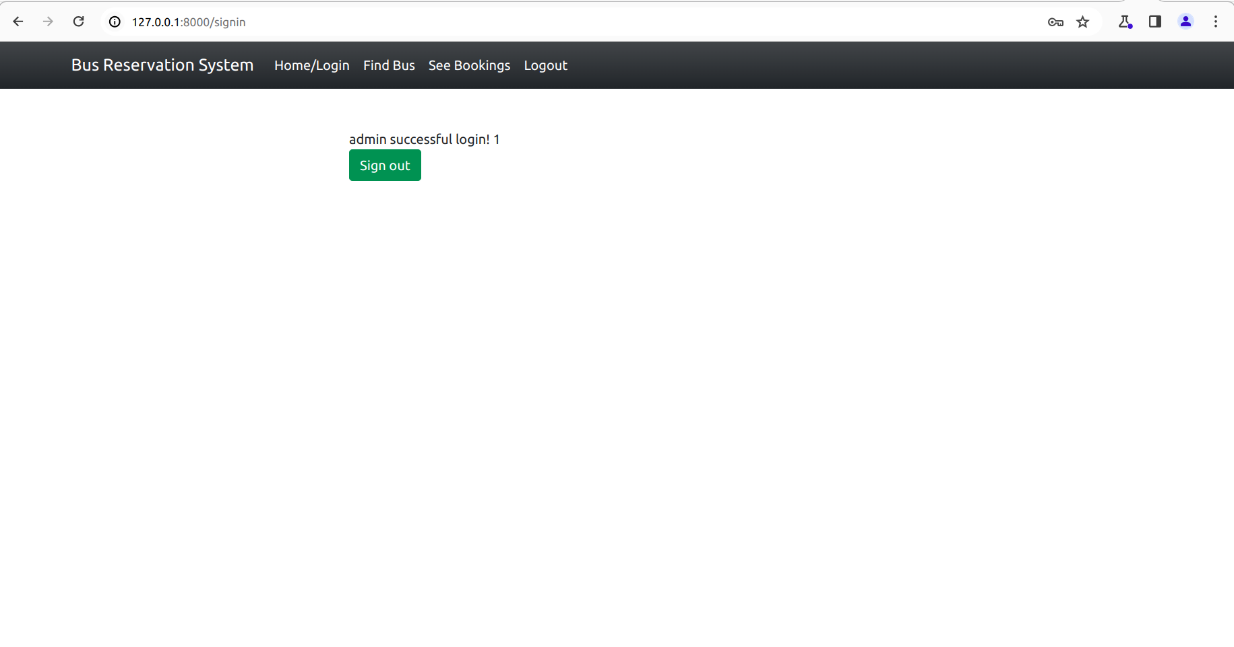
Successful-Login-Page

Slide 13
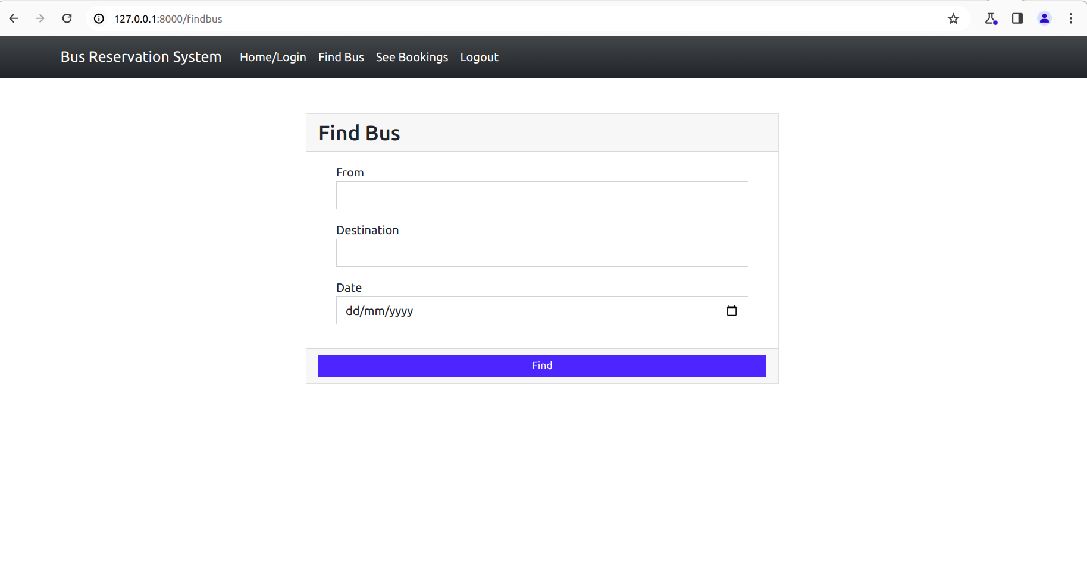
Find-Bus-Page

Slide 14
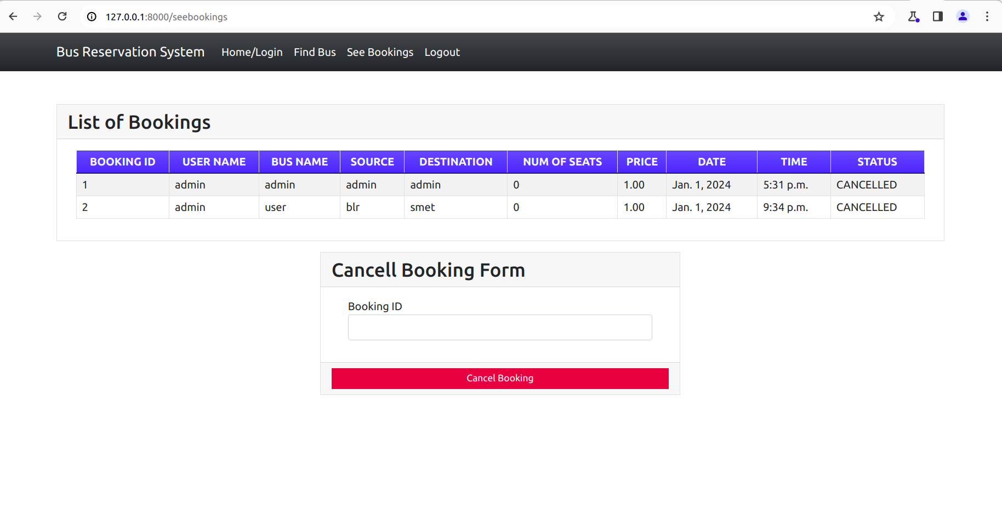
See-Bookings-Page

Slide 15
Conclusion :
The future enhancements outlined for the Bus Reservation System aim to enhance user experience, improve system functiona lity, and attract a wider user base. By developing a mobile app, implementing real-time tracking, dynamic pricing, and loyalty programs, the system can offer greater convenience and incentives for users. Features such as seat preferences, social integration, multi-language support, and accessibility enhancements will contribute to inclusivity and user satisfaction. Additionally, feedback systems and predictive analytics will enable continuous improvement and optimization of service quality and operational efficiency. Overall, these enhancements will position the Bus Reservation System as a leading platform for seamless and user-friendly bus ticket booking.
Source :

Slide 16
Thank You!
Notes:
Thank You !!

